Slide 1
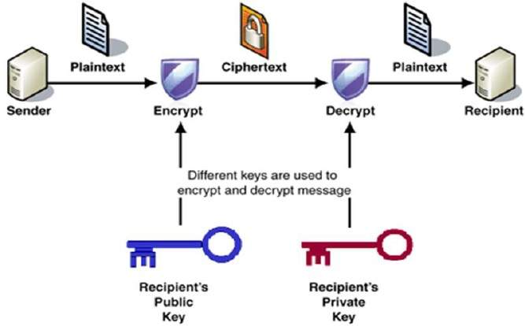
Modern Cryptography Algorithms and Their Applications

Slide 2
Cryptography Items
Plain Text : The original message (text, image ,video,… etc.
Cipher Key : Encryption works by running the data (represented as numbers) through a special encryption formula (called a key). Both the sender and the receiver know this key
Cipher text: Combination of plain text and the secret key
Decryption: Recovering information from cipher text

Slide 3
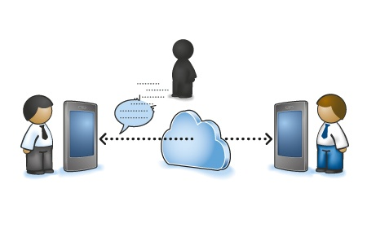
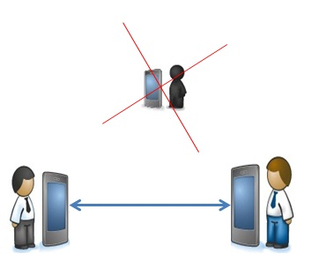
Security types
1- Communication Security: In this type the 3rd party can receive information but cannot know the information or change it
2- Transmission Security: In this type the 3rd party don’t know there is a communication or know but hasn't reception ability to listen

Slide 4
Cryptography Systems (History)
Substitutions: the Letters of plain text are replaced by other symbols , numbers, … etc.
Transposition: rearranging the order of the elements of the plaintext according to a proposed algorithm.
Polyalphabetic Ciphers :polyalphabetic cipher is a cipher where different substitution alphabets are used for various parts of the plaintext.
Running Key Ciphers: polyalphabetic substitution, where the secret key is repeated along the length of plaintext/ciphertext

Slide 5
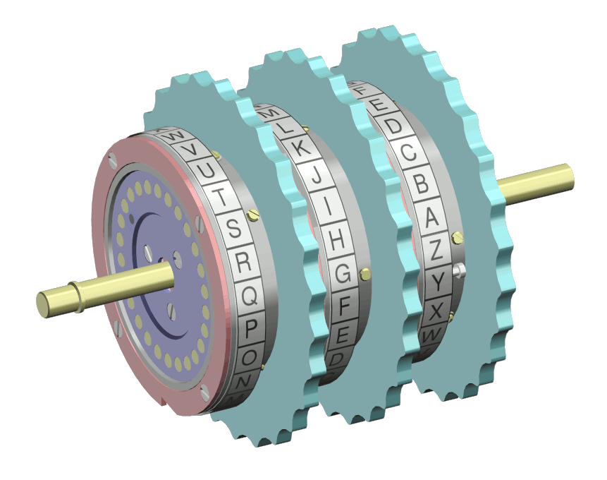
5- Roter Machines: Used a series of rotating cylinders to implement a polyalphabetic substitution cipher of period K, with 3 cylinders, K = ${26}^{3}$ $=17,576,$ with 5 cylinders, K = ${26}^{5} =12 x {10}^{6}$ and so on.
And other types.

Slide 6
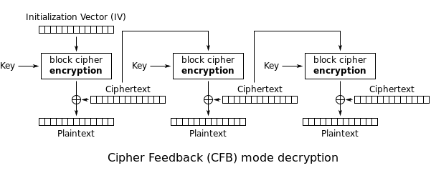
Structures Classification of Encryption
1- Block Cipher:
in this type asymmetric key is used, it encrypt n-bit block of plain text which controlled by a secret key , as the block size increase the security of encryption increase too but the complexity of decipher algorithms will also increase

Slide 7
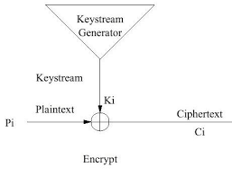
1- Stream Cipher:
in this type the plain text is processed bit by bit as a stream, in most stream cipher a Pseudo Random Number Generator (PRNG) is used to generate the secret key.

Slide 8
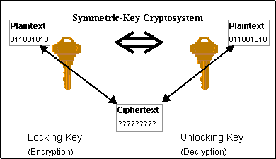
Classification according to the Keys
1- Symmetric-key cryptography
Symmetric-key cryptography refers to encryption methods in which both the sender and receiver share the same key (or, less commonly, in which their keys are different, but related in an easily computable way).

Slide 9
2- Public-key cryptography
cryptography in which two different but mathematically related keys are used—a public key and a private key . A public key system is so constructed that calculation of one key (the 'private key') is computationally infeasible from the other (the 'public key'), even though they are necessarily related. Since two keys are used in this method then it is called asymmetric encryption.

Slide 10
Percentage of Data Classification
1- Full Encryption:
This type offers a high level of security and effectively prevents unauthorized access. Images as a binary large objects or pixels are encrypted in their entirety.
1- Partial Encryption:
In this type, a part of data is encrypted therefor it is also called selective encryption.

Slide 11
Key Size
The size of the key space is the number of encryption/decryption key pairs that are available in the cryptosystem. If $k_{i}$ to denote a key and $K$to represent a finite set of possible keys, which is also called the key space and can be expressed as $K=\{k_{1}+k_{2}+k_{3}+…\}$

Slide 12
Attacks Classification
1- Cipher text only attack
2- Known plain text attack
3-Chosen plain text attack
4- Chosen cipher text attack
5- Brute Force Attack

Slide 13
Chaos System
The word chaos has been derived from the Greek, which refers to unpredictability which is a mathematically physic which was developed by Edward Lorenz
There exist two approaches of designing chaos-based cryptography
1- analog
Which are secure communication schemes designed for noisy channels based on the technique of chaos synchronization
2-Digital
Are designed where one or more chaotic maps are implemented in finite commuting precision to encrypt the plain- messages in a number of ways

Slide 14
Linear Chaos System
A linear process is one in which, if a change in any variable at some initial time produces a change in the same or some other variable at some later time.
Non Linear Chaos System
All systems that are not linear are called Nonlinear systems. In these systems, the change in a variable at an initial time can lead to a change in the same or a different variable at a later time, that is not proportional to the change at the initial time.

Slide 15
Properties Chaos System
1- Deterministic
Which means that the chaotic systems have some mathematical equations ruling their behavior
2- Sensitivity
These system is sensitive to initial conditions and parameters which make them change quickly
3- topological transitivity
Is the tendency of the system to quickly scramble up small portions of the state space into intricate a network of filaments.

Slide 16
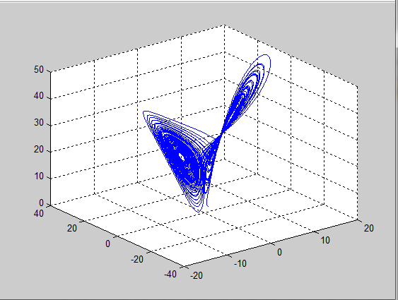
Some Examples of Chaos System
1- Lorenz System
Deterministic Non periodic Flow which has the following dynamic equations
$\frac{dx}{dt}=a\left(y−x\right)$ , $\frac{dy}{dt}=bx−zx−y$,$\frac{dx}{dt}=xy−cz$

Slide 17
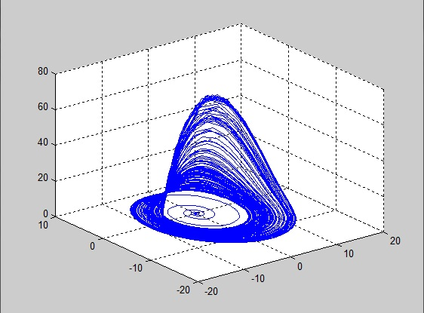
2- Rossler System
Otto E. Rossler tried to enhance Lorenz attractor and design this model which consists only one non- linear term ($xz$) and the non-linear ordinary differential equations
$\frac{dx}{dt}=\left(−y−z\right)$ , $\frac{dy}{dt}=x+ay$,$\frac{dx}{dt}=b+xz−cz$

Slide 18
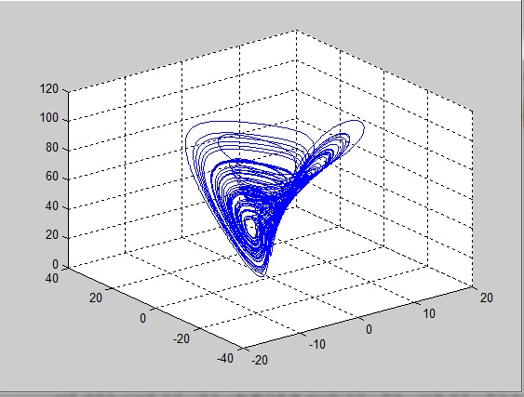
3- Liu System
The master system is described by the Liu dynamics equations
$\frac{dx}{dt}=a\left(y−x\right)$ , $\frac{dy}{dt}=bx−x$z,$\frac{dx}{dt}=−cz+dx^{2}$

Slide 19
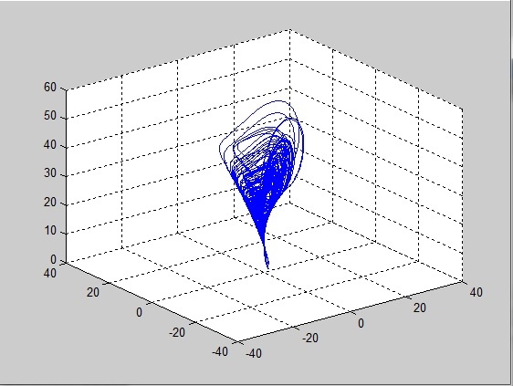
4- Chen System
Chen system can be applied to designing a cryptosystem with higher security. Chen dynamical system is described by the following system of differential equations
$\frac{dx}{dt}=a\left(y−x\right)$ , $\frac{dy}{dt}=\left(c−a\right)x−xz+cy$,$\frac{dx}{dt}=xy−bz$

Slide 20
Encryption based Chaotic System
1- Confusion
This process refers to substitutions which intend to make the relation ship between the key and the cipher text as complex as possible
1- Diffusion
This process refers to rearranging or spreading out the bit of the message , to obtain new values which can be obtained again by the receiver

Slide 21
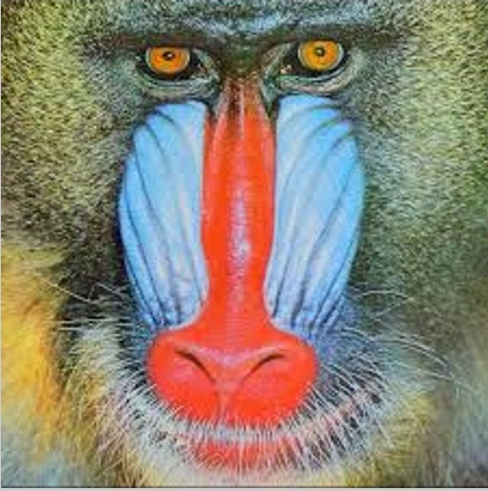
Examples of Image Encryption
1- Baboon Cryptography
Original Image
Encrypted Image
Decrypted Image

Slide 22
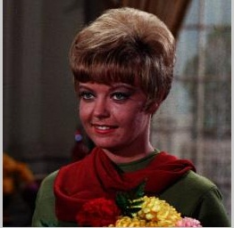
2- Girl Cryptography
Original Image
Encrypted Image
Decrypted Image

Slide 23
2- Flower Cryptography
Original Image
Encrypted Image
Decrypted Image

Slide 24
References
1- Eng. Ibrahim Fathy El-Ashry “Digital Image Encryption”, Menofia University Faculty of Electronic Engineering Dept. of Electronics and Electrical Communications Engineering, 18, No. 3, pp. 1-14, 2009.
2- Afnan Sameer Yaseen Al-Ali Eng. “Chaos Encryption Methods for Partial Encryption of Wavelet-based Images,” , University of Basrah. 2005
3- Yaobin Mao1 and Guanrong Chen2” Chaos-Based Image Encryption” 1 Nanjing University of Science and Technology maoyaobin@163.com 2 City University of Hong Kong gchen@ee.cityu.edu.hk
4- Sunil Pandey, Praveen Kaushik, Dr. S.C. Shrivastava” Rossler Nonlinear Dynamical Machine For Cryptography Applications”
5- Pianhui awu “ research on digital image Watermarking based on Hyper Chaos ” University of Derby , May 2003.
6- Edward N. Lorenz ”Deterministic Non-Periodic Flow” 7jenuary ,1963.
7- Gonzalo Alvarez1 and Shujun Li2” Some Basic Cryptographic Requirements for Chaos-Based Cryptosystems” International Journal of Bifurcation and Chaos, vol. 16, no. 8, pp. 2129-2151, 2006.

Slide 25
Thanks
a lot

Slide 26
Any Questions

